Slide 1
Python Data Analysis Project
Creator : Rahmoni Adamov

Slide 2
The problem:
I’m Trying to Predict through the Churn Data which elements causes the highest churn percentage.
The data that available for that cause is the churn data set ( Seniority,Tenure,contract etc)
The motivation behind of solving the problem starts with get the stability for the organization and ends up with growing the business customer population

Slide 3
Data description:
There are 7043 lines within the dataset , for testing i have used 2,000 customers and the rest used for training
there are 20 features in the dataset some of them irrelevant and some of them needed to be manipulated in order so i can use them to get the right conclusions.
after i have searched for some missing values ( nan/nulls) i found that in total charges there was 11 empty values “ “ , after a deep check i got to an assumption that is equal to 0 charges and that what i replaced instead.

Slide 4
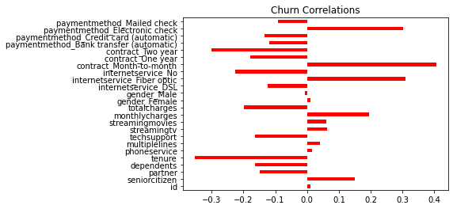
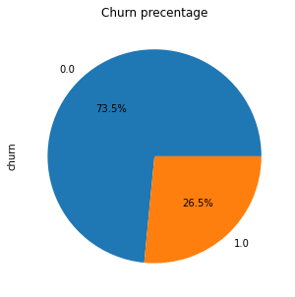
Various aspects of the data by visualization graphs

Slide 5
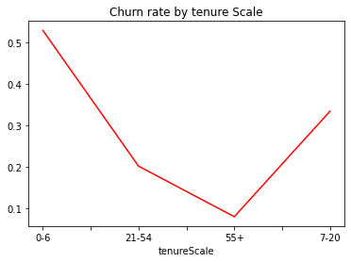
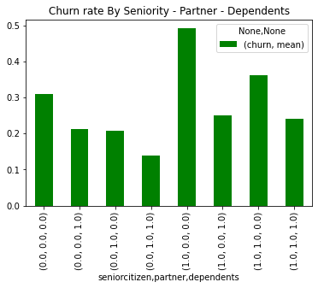
on the first graph we can see clearly that the churn rate is higher within the lower Tenure scale
somewhere between 0-6 tenure and also 7-20
that tells us that the higher tenure of the customer the higher percentage that he will stay loyal to the organization.
on this second graph i check the churn ratio of three components : Seniority , Partner and Dependents.
the results are crystal clear : seniors with no partner and no dependents are more likly to churn then the others.

Slide 6
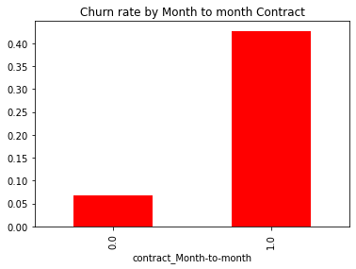
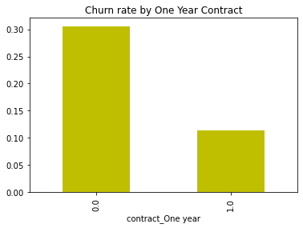
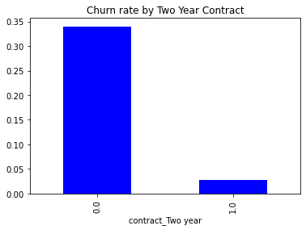
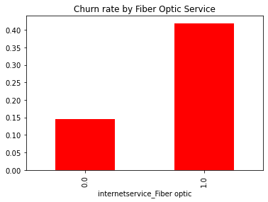
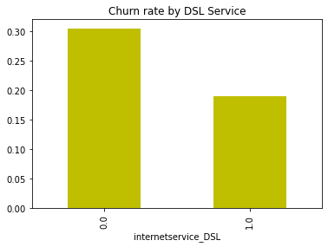
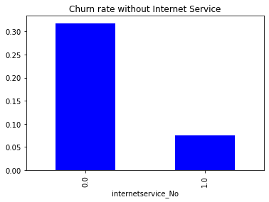

Slide 7
Data engineering:
within data engineering i decided to remove some columns in the dataset like : Paperless billing ,Online Security, Device Protection, Online Backup and also changed to Customer ID to numeric one
also i have added the Tenure Scale feature that will help divide the customers and sort them as groups in order to to make the data more clear as also mentioned and shown in the tenure graph line before.
about missing values and missing strings i replaced with the right value as for example 0 in total charges where there was none value as was explained earlier as well.

Slide 8
ML Algorithms:
over the project i have tested the algorithms with some possibilities to get the best prediction
K nearest neighbors, 3 different k values
n_neighbors=3 - was 71.25%
n_neighbors=9 - was 73.85%
n_neighbors=12 - was 75% the closest prediction with K test
Decision tree with 3 different max depth values
max_depth=2 - was 75.7%
max_depth=5 - was 79.05% the closest prediction with Decision Tree
max_depth=99 - was 72.95%
Random Forest with 3 different max depth values and 100 estimators
n_estimators=100, max_depth=3 - was 77.95%
n_estimators=100, max_depth=5 - was 79.3%
n_estimators=100, max_depth=9 - was 79.75 the closest prediction with random forest .

Slide 9
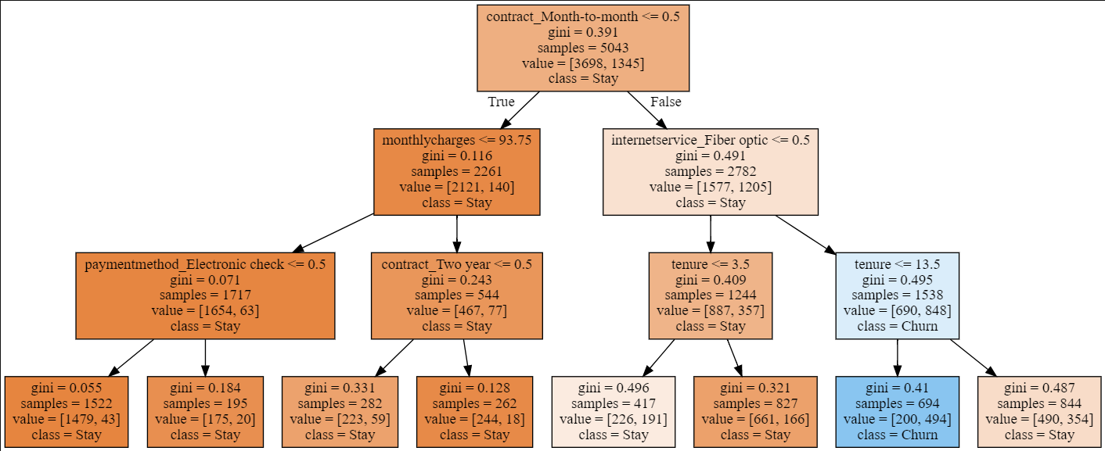
Algorithms introspection:
Decision Tree:

Slide 10
the random forest feature importance
It is a set of Decision Trees. Each Decision Tree is a set of internal nodes and leaves. In the internal node, the selected feature is used to make decision how to divide the data set into two separate sets with similars responses within. The features for internal nodes are selected with some criterion, which for classification tasks can be gini impurity or information gain, and for regression is variance reduction. We can measure how each feature decrease the impurity of the split (the feature with highest decrease is selected for internal node). For each feature we can collect how on average it decreases the impurity. The average over all trees in the forest is the measure of the feature importance.

